Slide 1
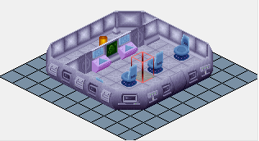
I took a small ufo (ox_ufo1e) as example to ask some questions

Slide 2
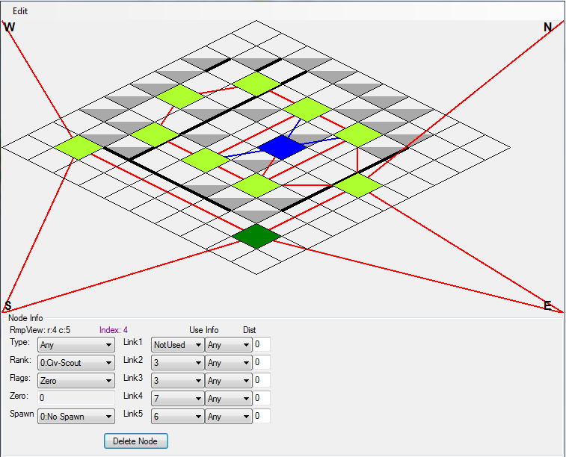
1
As links seem to be activated in both directions,
why is this link not (blue), is it a mistake/oblivion ?
A link can either single direction or go in both directions, that one you found is most likely a mistake however , there is no reason you can use single directions to enforce a patrol direction

Slide 3
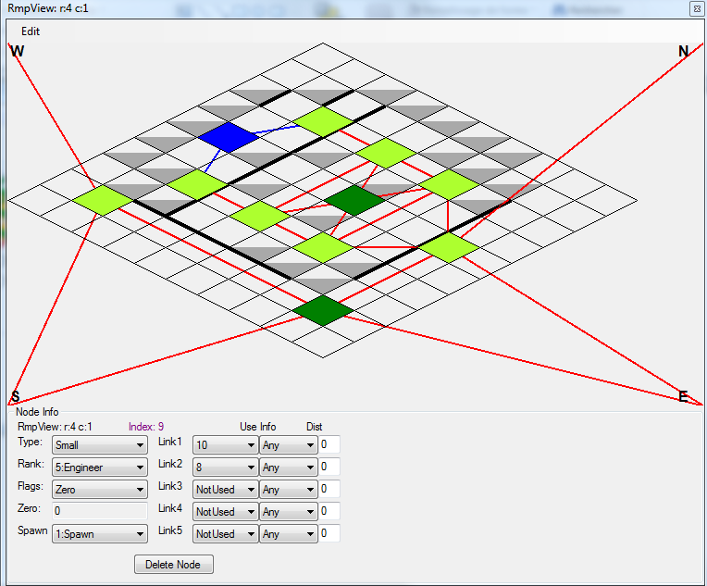
2
All nodes are of type « Any », but both these are of type « Small »
How to determine type of node ?
3
The ANY is to restrict what types can pass onto the Node, i prefer to leave most as ANY except for entering doors that are too narrow for large units, those ones i usually restrict
As for the Node types , i originally tried to to match what the original ship had ( numbers of each unit type) i soon just started adding what ever i needed. The ruleset will restrict what types spawn, but you can really do anything you like.
I try to explain what I understand about it
As small ufos have no large units declared in alien_deployment section (in ruleset), it is same to declare small or any, regarding of size : right ?
In case of floaters, nodes of type small will just be ignored : right ?
In this case, why not all just of type any ?

Slide 4
Yes , these allow travel to other map blocks, as far as i know there is no restrictions on number of links to other maps , once again , i try to match original rules to prevent issues
4
Outside nodes seem to be linked with eventual external map blocks
Is it a way to allow for aliens to enter another map block ?
If yes, is there any rule, I mean for example « not more than two links ufo->external_map_block per outside node » ?

Slide 5
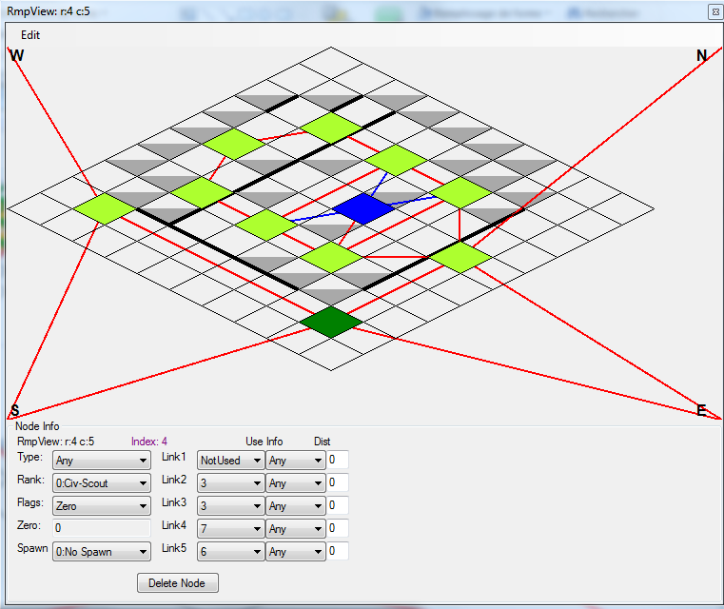
5
There are two green nodes, of Rank Civ-Scout
What is use of Civ-Scout Rank ?
Is there any rule to set some ?
Does « Civ-Scout » always imply « No-Spawn »
Civ/Scout in original game Civscout nodes can be used on UFOs and is used as a Overflow of sorts for the aliens , this is why sometimes you would find aliens standing on the roofs of Ufos.

Slide 6
looks like a stuff-up, stuff like that needs to be fixed
6
Both these node are not directly linked
Is there any rule ?
In this case, could these nodes be linked together ?

Slide 7
Yep , you can use all 5 nodes
7
Link 1 is not used
It seems we may use any of 5 available links, I mean, for a three-links node, it has same behaviour to use links {1,2,3} or {2,3,5} or … : right ?

Slide 8
I just ignore them generally , when i do open a new map type i usually have a quick look at what the ORIGINAL game had but so far i have had no issue
8
Flags, Zero, Info and Dist seem to be of no use
May I just ignore these attributes : right ?

